Slide 1

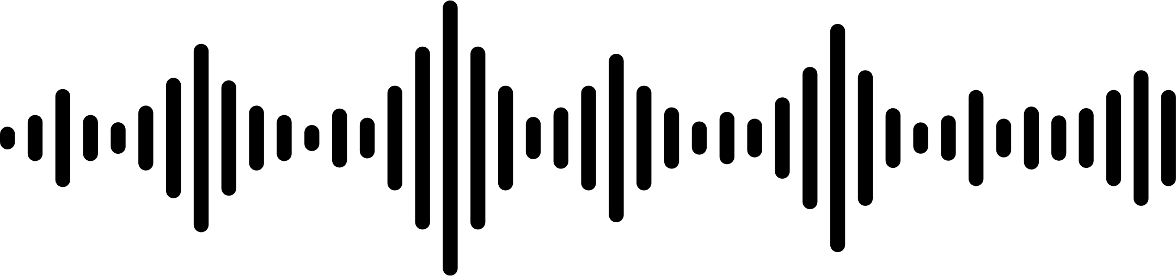


REPLICATING AND EXTENDING THE TRADITIONAL PHASE VOCODER
Group 9

Slide 2


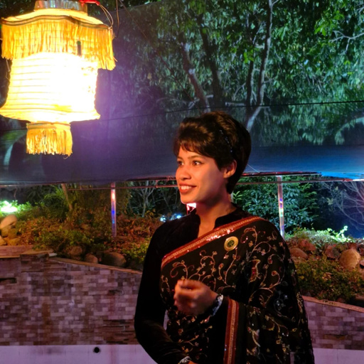
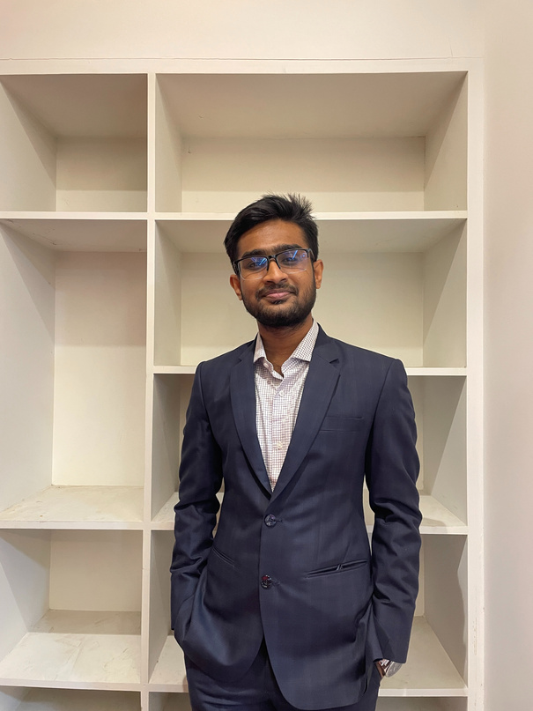
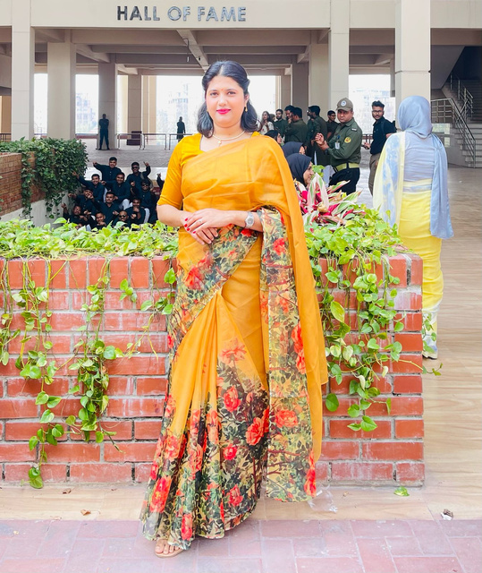
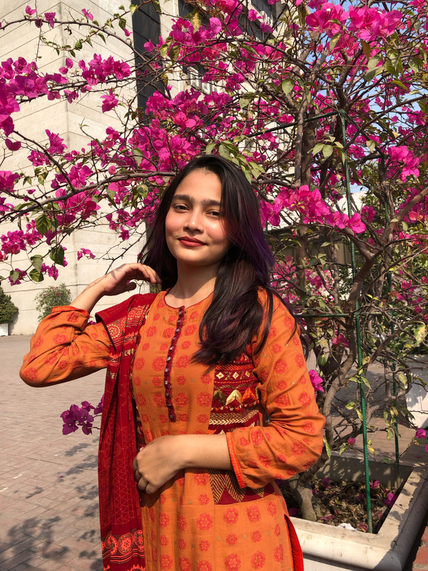
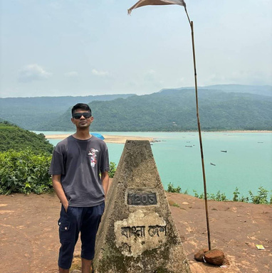
MEET OUR TEAM
TASHNOVA ELAHI\
202116170
PRETOM DAS
202216072
SHEIKH IFFAT
ARA PRIANKA
202216091
ZAKIA SULTANA
SIMIN
202216112
ABDULLAH AHNAF
KARIM
202216303

Slide 3
OBJECTIVE
01.
DEVELOP AN INTUITIVE MATLAB GUI FOR PHASE VOCODER EFFECTS.
02.
IMPLEMENT TIME-STRETCHING AND PITCH-SHIFTING FUNCTIONALITIES.
03.
INTEGRATE ADDITIONAL EFFECTS: REVERB, ECHO, DISTORTION.
04.
PROVIDE REAL-TIME VISUALIZATION OF AUDIO SIGNALS.

Slide 4
LITERATURE REVIEW
01.
THE PHASE VOCODER (PV) IS ESSENTIAL IN SPEECH AND AUDIO PROCESSING, ENABLING TIME-STRETCHING AND PITCH-SHIFTING APPLICATIONS
02.
TRADITIONAL IMPLEMENTATIONS OFTEN SUFFER FROM PHASE DISTORTION AND ARTIFACTS, LIMITING EFFECTIVENESS IN EXTREME AUDIO MODIFICATIONS
03.
A COMPREHENSIVE MATLAB-BASED IMPLEMENTATION HAS BEEN DEVELOPED, PROVIDING A ROBUST FRAMEWORK FOR RESEARCH AND DEVELOPMENT
04.
ONGOING RESEARCH CONTINUES TO IMPROVE PRECISION AND REDUCE ARTIFACTS, BROADENING PV'S APPLICABILITY IN ACADEMIC AND COMMERCIAL DOMAINS.

Slide 5
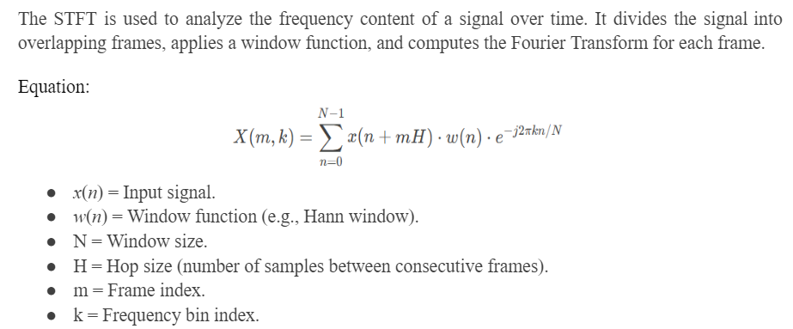
THEORETICAL BACKGROUND
SHORT-TIME FOURIER TRANSFORM (STFT)

Slide 6
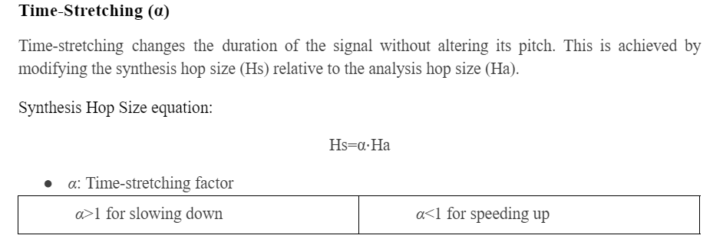
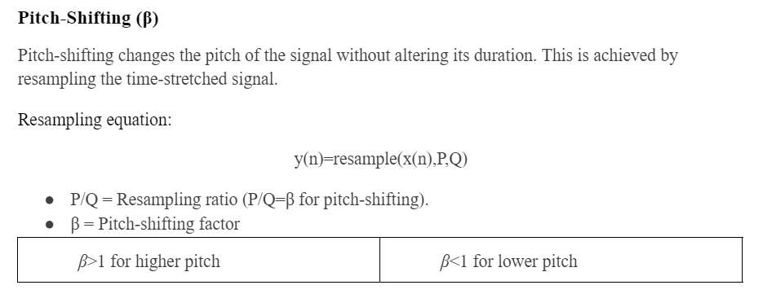
THEORETICAL BACKGROUND

Slide 7
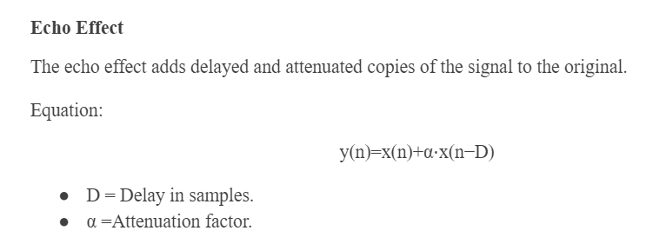
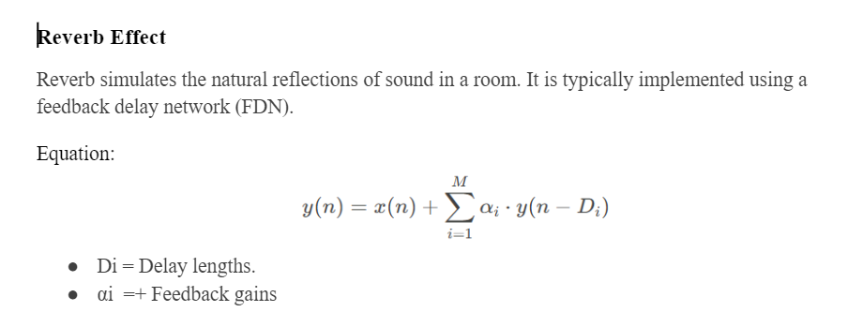
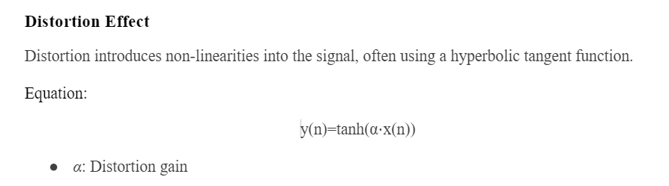
THEORETICAL BACKGROUND

Slide 8
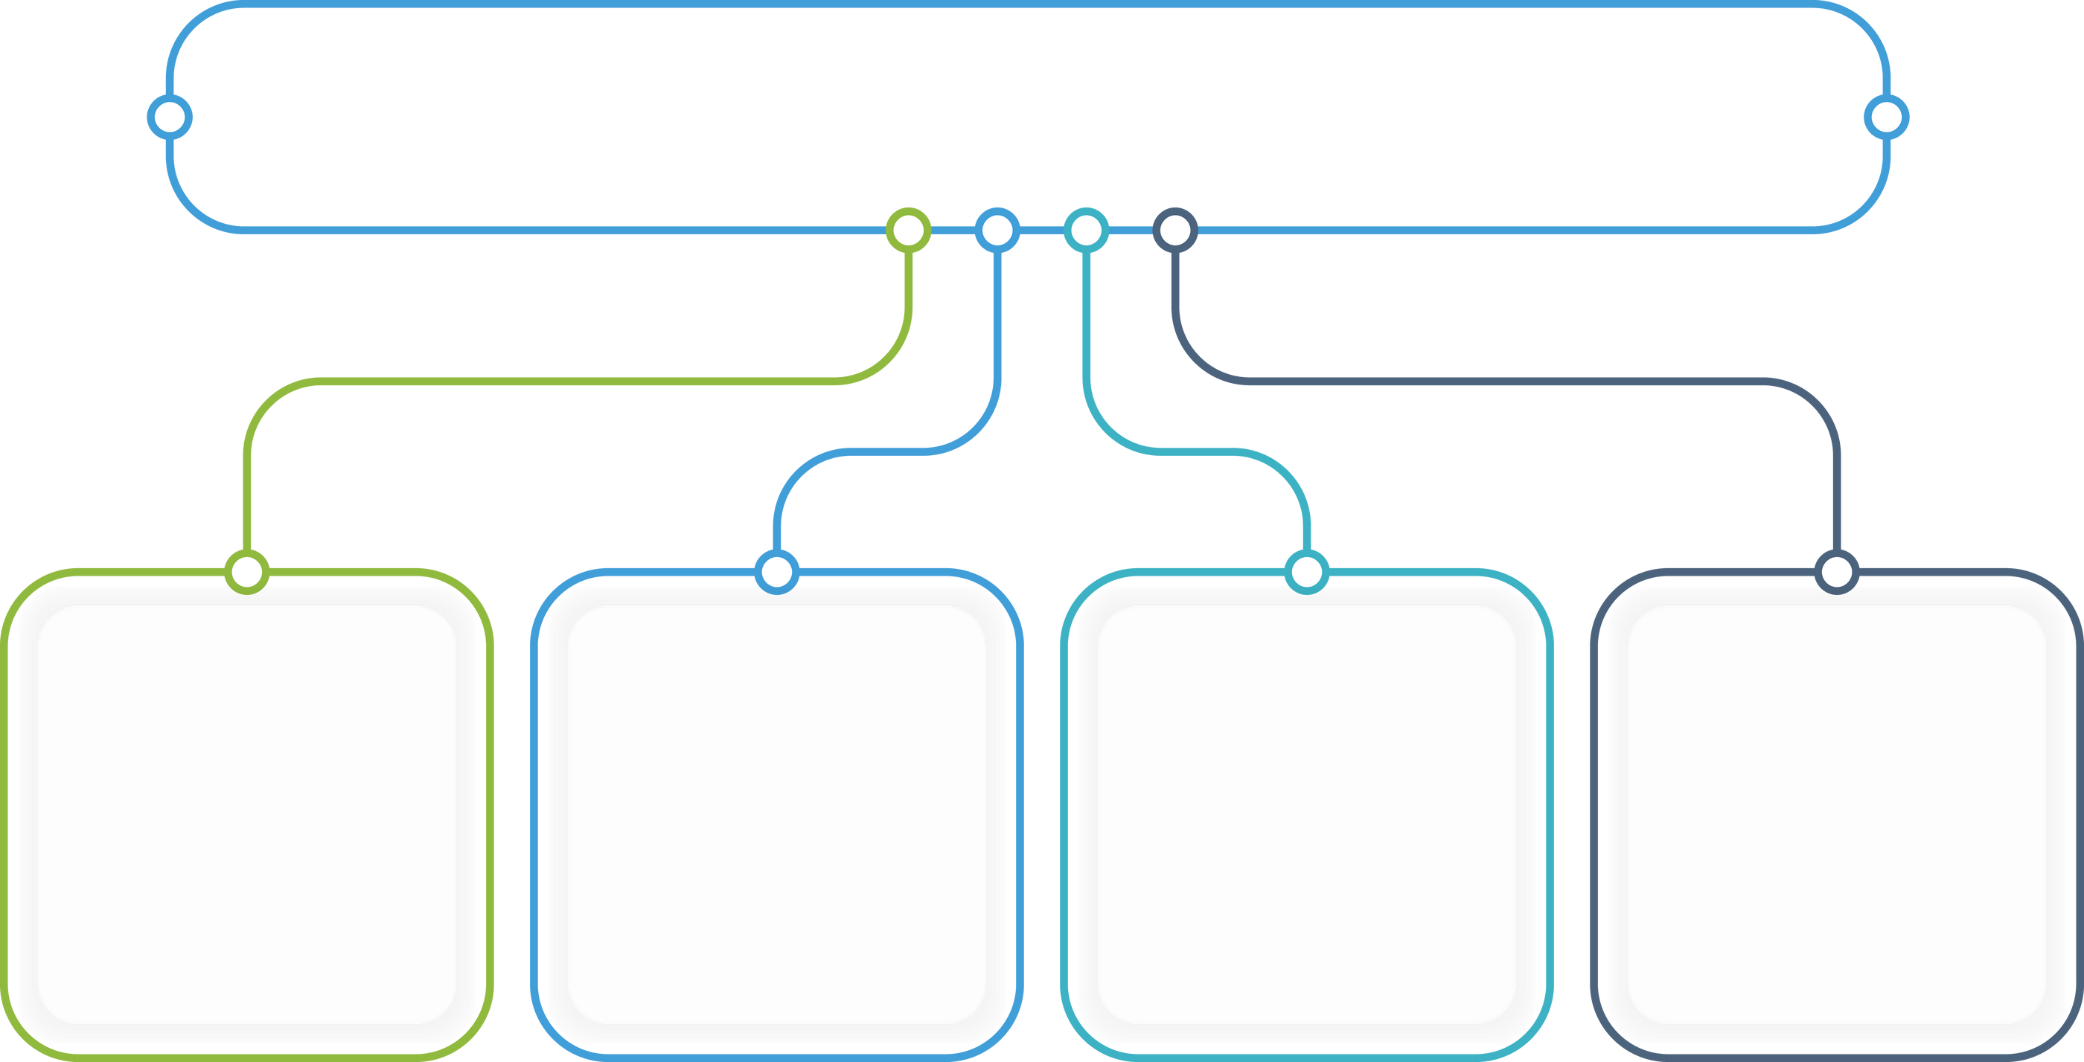
THEORETICAL BACKGROUND
SHORT-TIME FOURIER TRANSFORM (STFT)
TIME-STRETCHING
PITCH-SHIFTING
EFFECTS PROCESSING

Slide 9
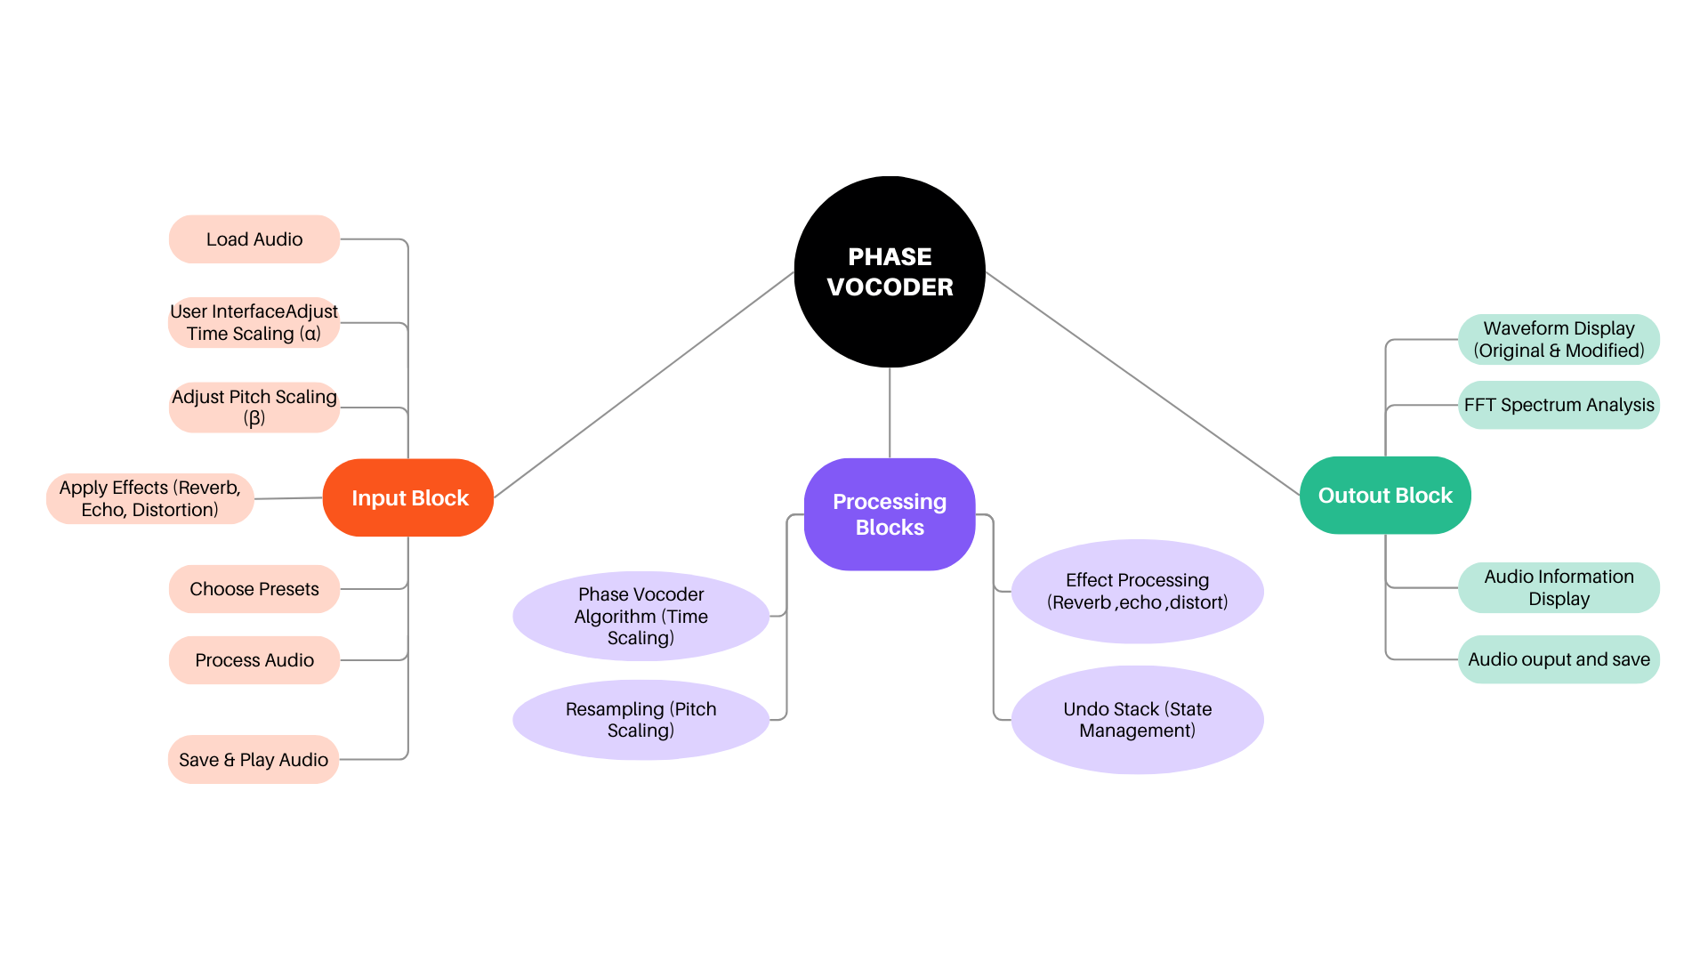
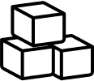
BLOCK DIAGRAM

Slide 10
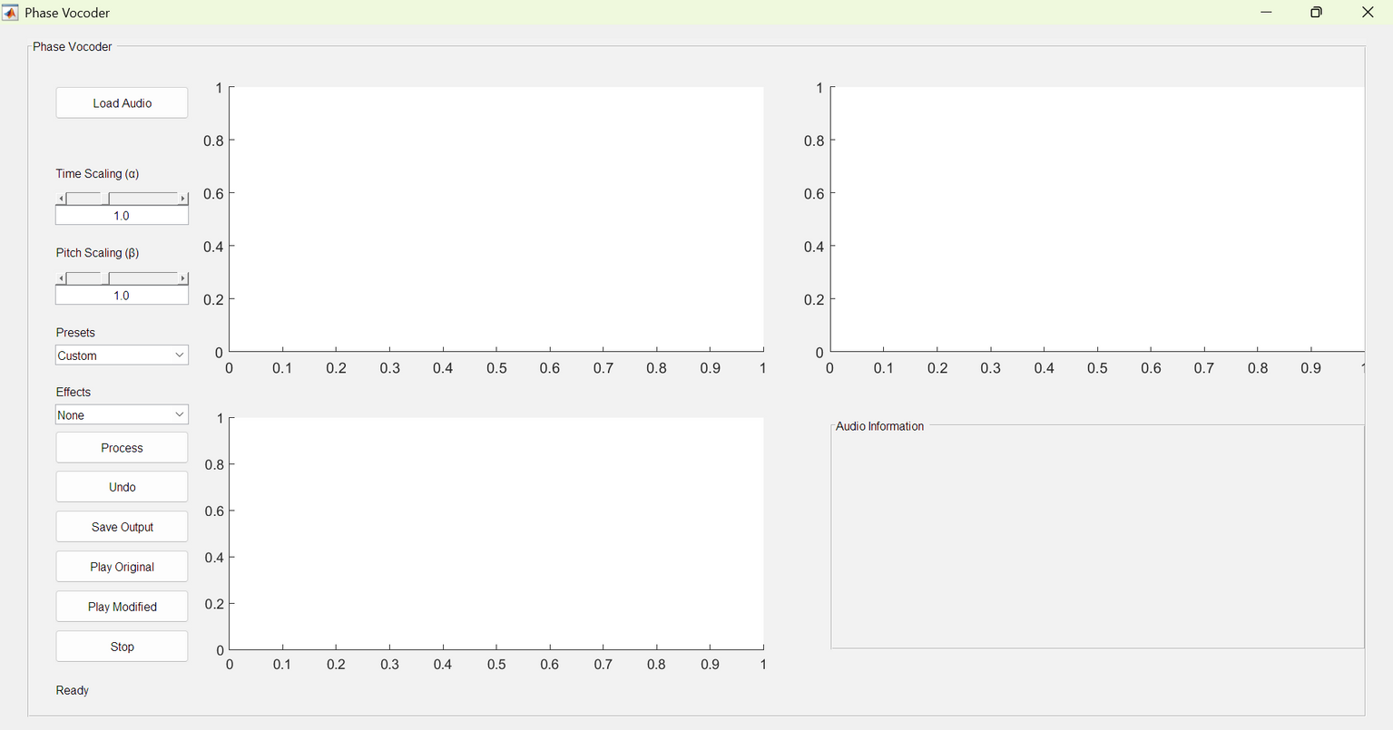
GUI

Slide 11
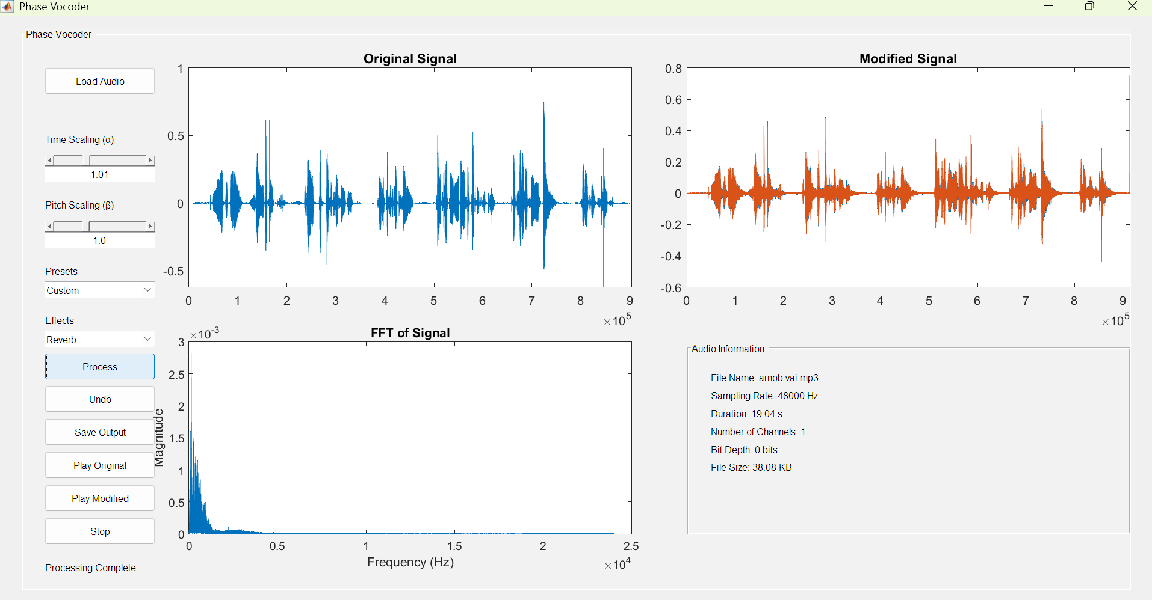
GUI

Slide 12
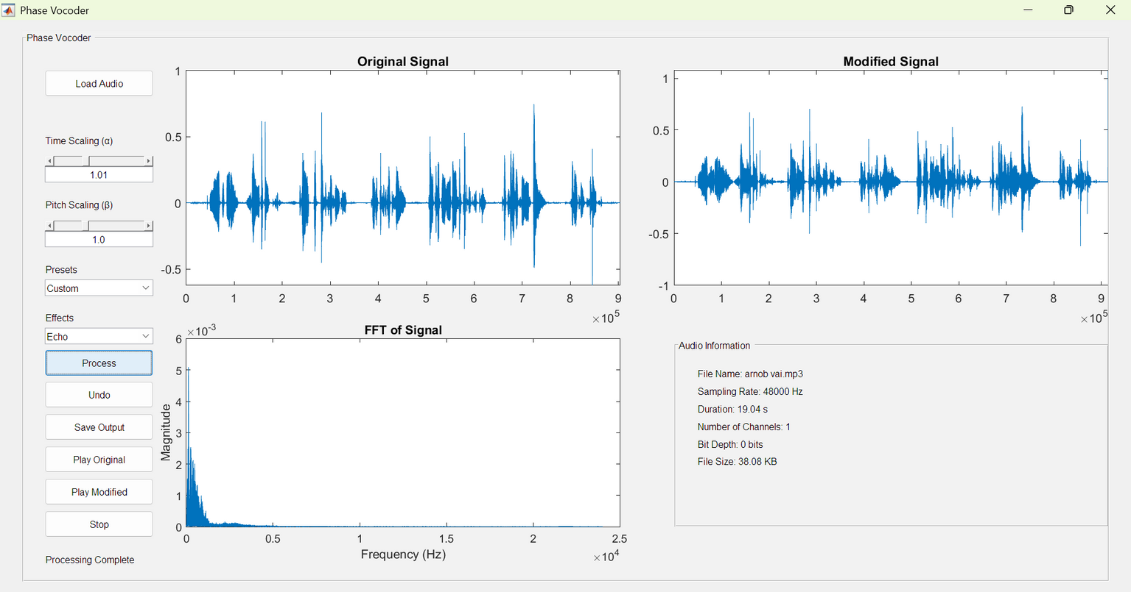
GUI

Slide 13
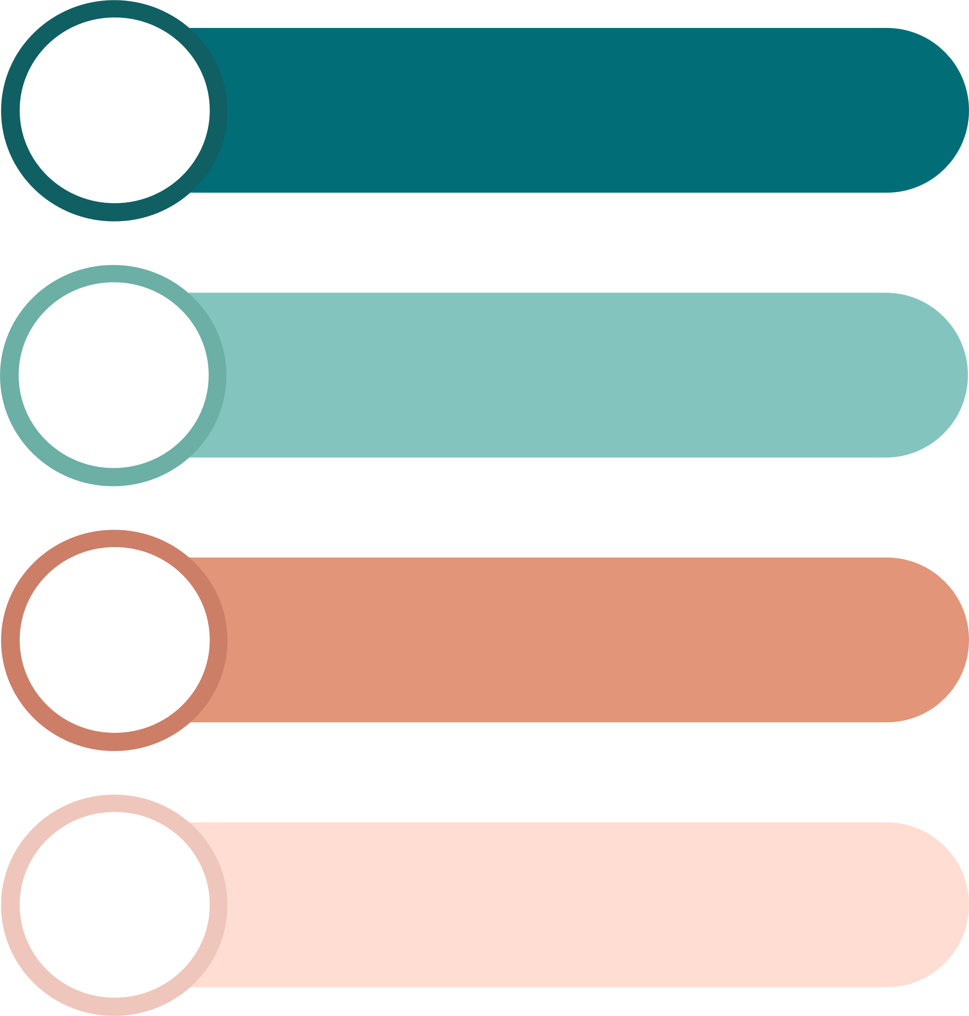
GUI FEATURES
LOAD, PROCESS, AND SAVE AUDIO FILES.
ADJUSTABLE SLIDERS FOR TIME-STRETCHING & PITCH-SHIFTING.
EFFECTS MENU WITH MULTIPLE SOUND MODIFICATIONS.
GRAPHICAL VISUALIZATION OF WAVEFORMS AND FREQUENCY SPECTRUMS.

Slide 14
SCOPES
1
2
ADDITIONAL AUDIO EFFECTS
MULTI-TRACK SUPPORT
More audio effects, such as chorus, flanger or parametric equalization, can be added to provide users with a wider range of creative options. This would allow for more advanced audio manipulation and customization.
Support for loading and processing multiple audio tracks simultaneously can be added. This would enable users to work on more complex audio projects, such as mixing or layering sounds
Features like formant preservation during pitch shifting and transient preservation during time scaling can be implemented. These would help maintain the natural characteristics of voices and instruments, especially for complex audio signals.
A batch processing feature can be added to allow users to apply the same effects and scaling parameters to multiple audio files at once. This would save time when working with large datasets or multiple file
ADVANCED PHASE VOCODER FEATURE
BATCH PROCESSING
3
4

Slide 15
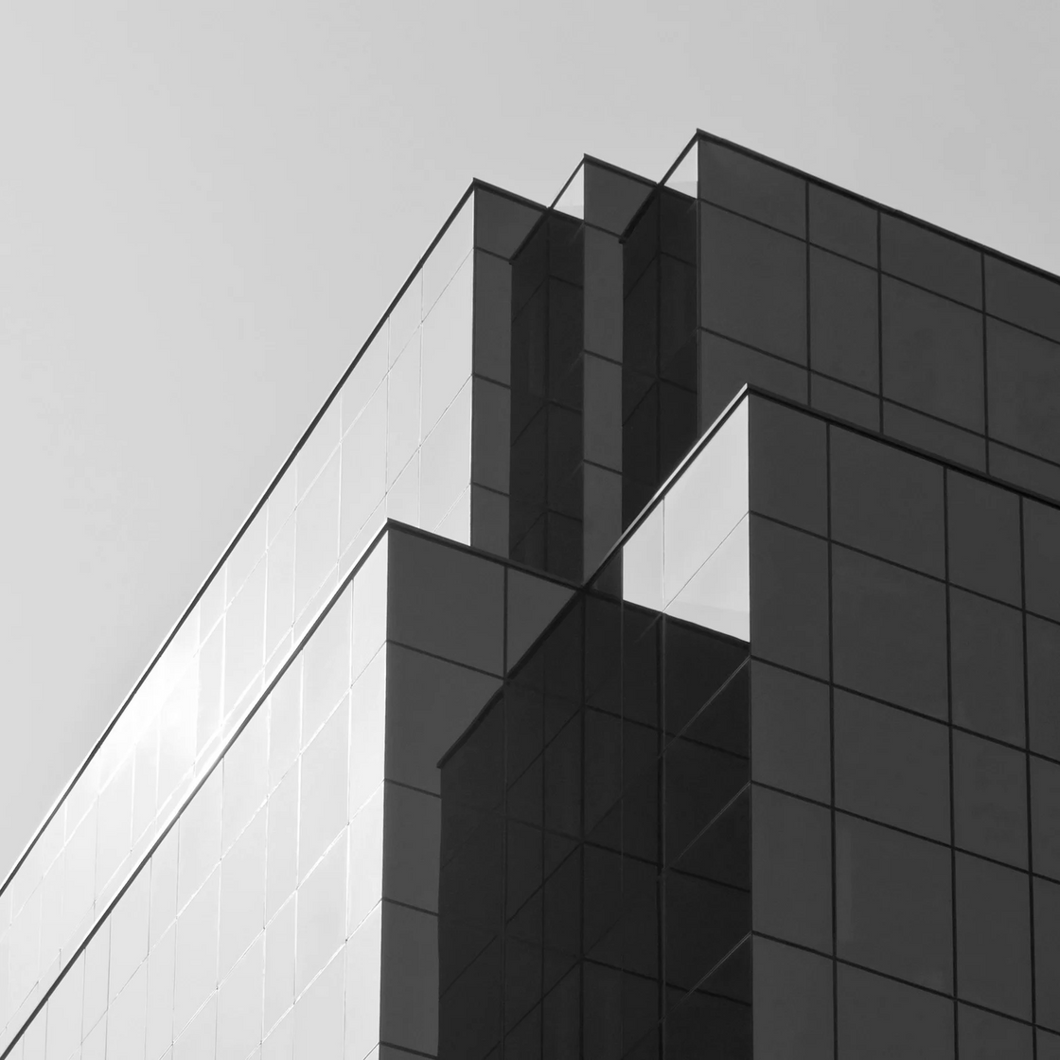
CONCLUSION
In this DSP project we have tried to implement all the DSP tools that we have learned through out the semester. In this project we have made use of SFFT, delay, resampling, non-linear distortion, pitch and phase shifting.

Slide 16
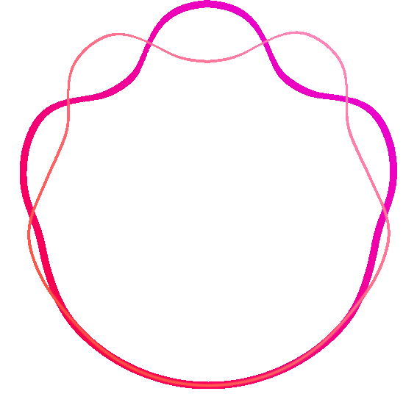
THANK YOU
Any Questions

